Slide 1

Red v. Blue
UC Irvine Cyber Security
Instructors:
Johnny Villareal
Michael Bermingham
Teaching Assistance:
Dennis Tran
Michael Martin
By: Grant
Guadalupe Luna
Jin Mok
Joe Lam
Benjamin Halpern
Date: 08/23/2019

Slide 2
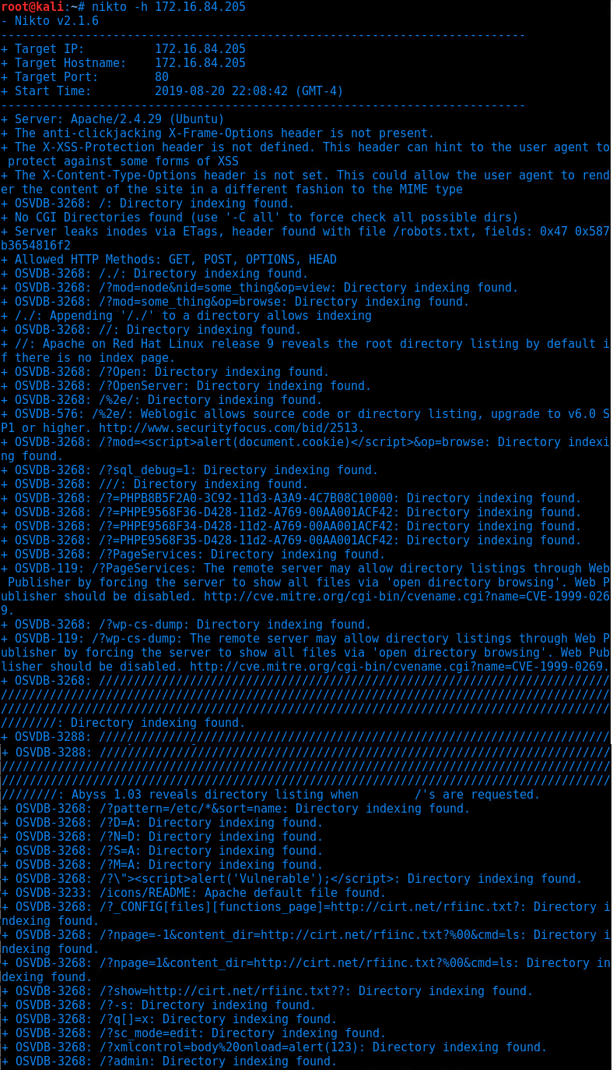
Vulnerability Assessment
Nikto & skipfish
Server runs on Apache/2.4.29
Allowed HTTP GET/POST/OPTIONS/HEAD
Directory indexing & listing Enabled - Opened to public.
SSH Connection - Brute forcible.
Secret Company Folder listed on the web.
PHP Server-side script exploitable.
No login attempt lockout nor 2-factor authentication.
Password not masked, shows as plaintext.
/?admin directory available as admin.
Needs to implement Principle of Least Privilege.
Weak credentials as for executives of the company.
Basic Authentication - base64 & plaintext can be used to pass the hash.

Slide 3
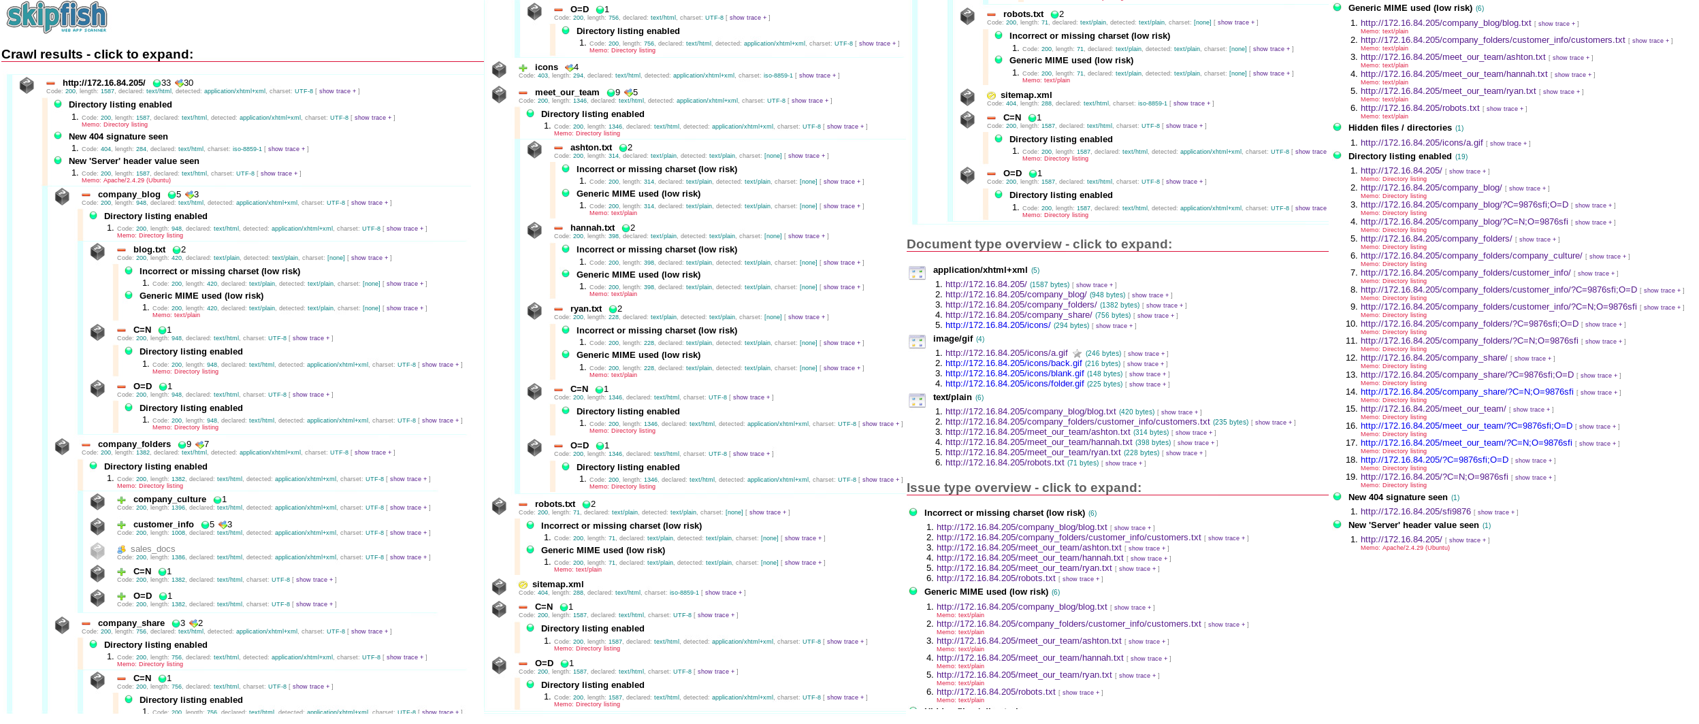
Skipfish - Vulnerability Assessment Report
Syntax: skipfish -o /root/Raven http://172.16.84.205

Slide 4
Nikto - Web Vulnerability Scanner
Hash-Identifier - Identifying Hash Algorithm
Netdiscover - ARP Scanner
Nmap - Port/OS Version/Protocol Type Enumeration & Scanner
Skipfish - Active web reconnaissance tool.
KALI LINUX TOOLS - ENUMERATION & HASH TYPE ID TOOLS
Syntax: $nikto -h 172.16.84.205
$nmap -sn 172.16.83.0/24 <= Scanning subnet
$nmap -A -sT -sV -sC -T4 -v 172.16.83.205
$netdiscover -r 172.16.83.205
$skipfish -o /root/filedir http://172.16.83.205

Slide 5
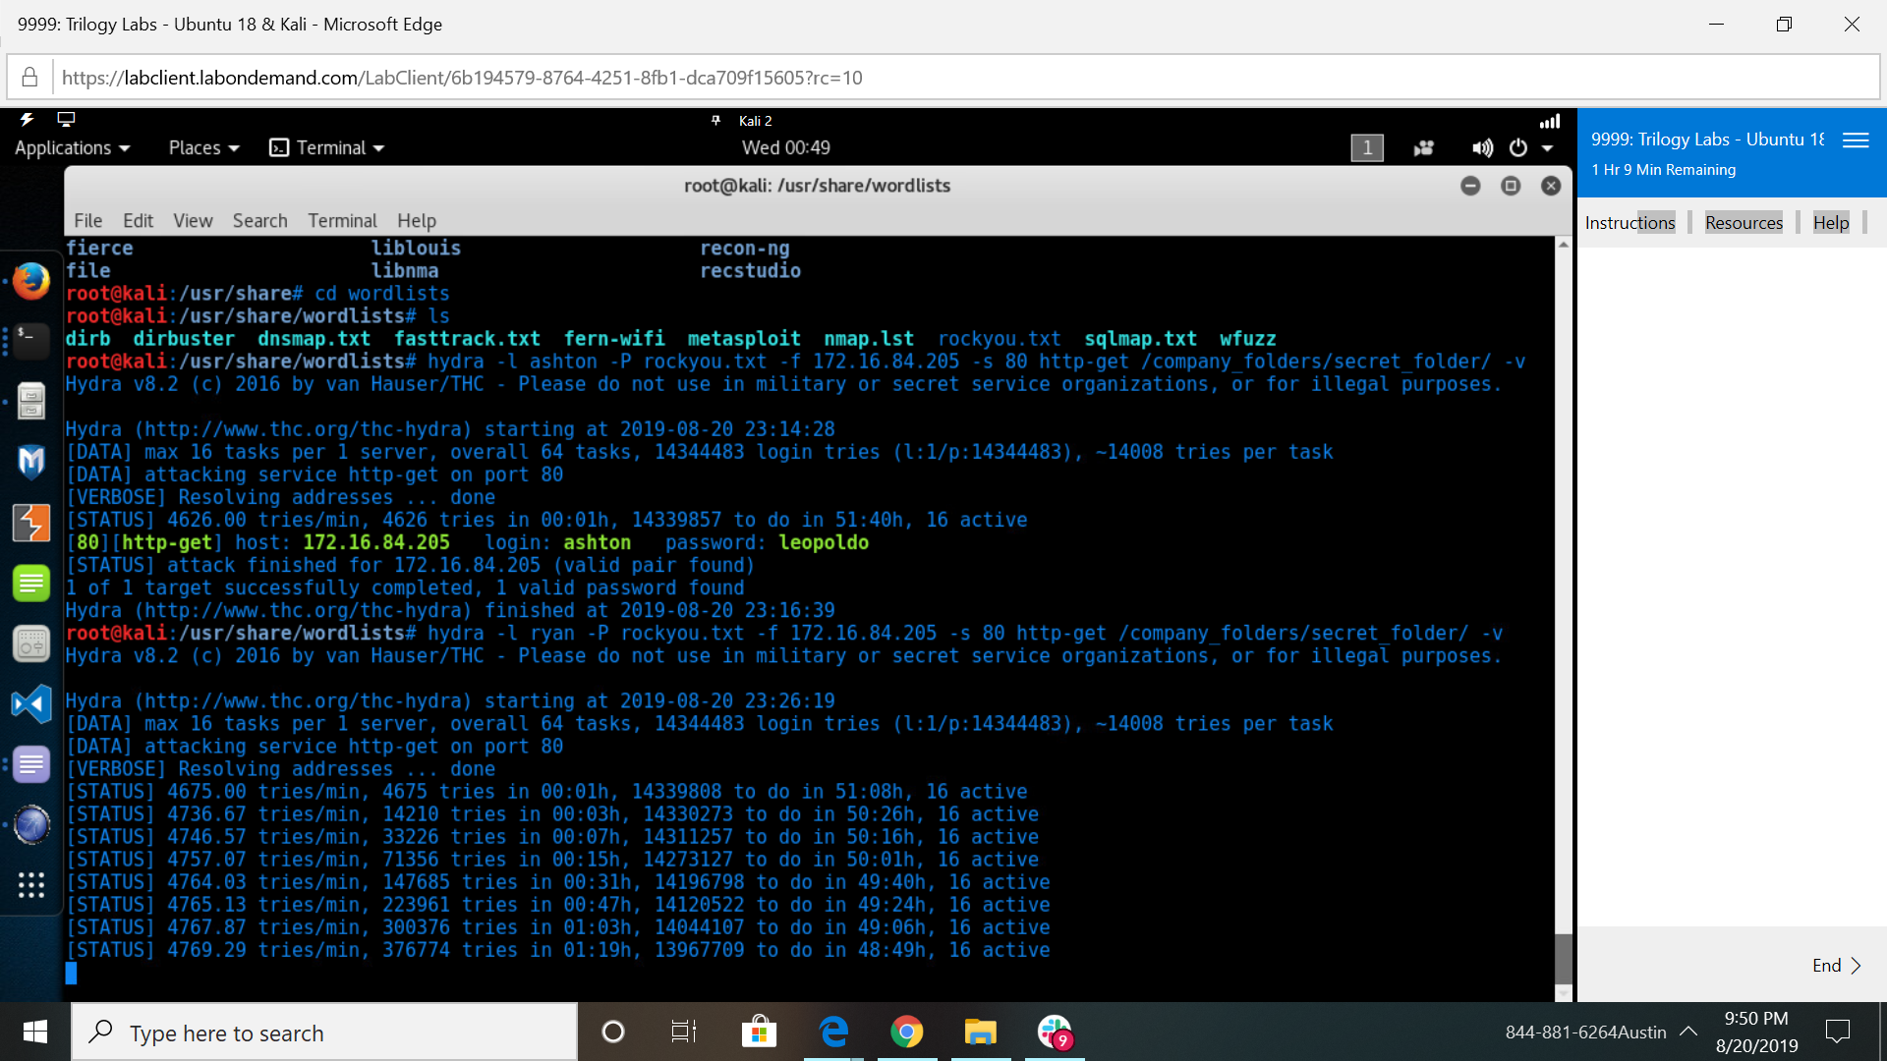
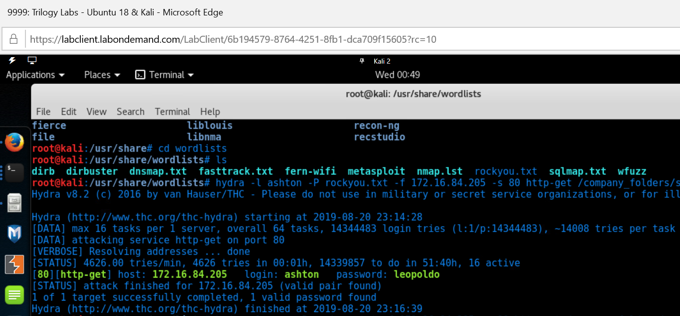
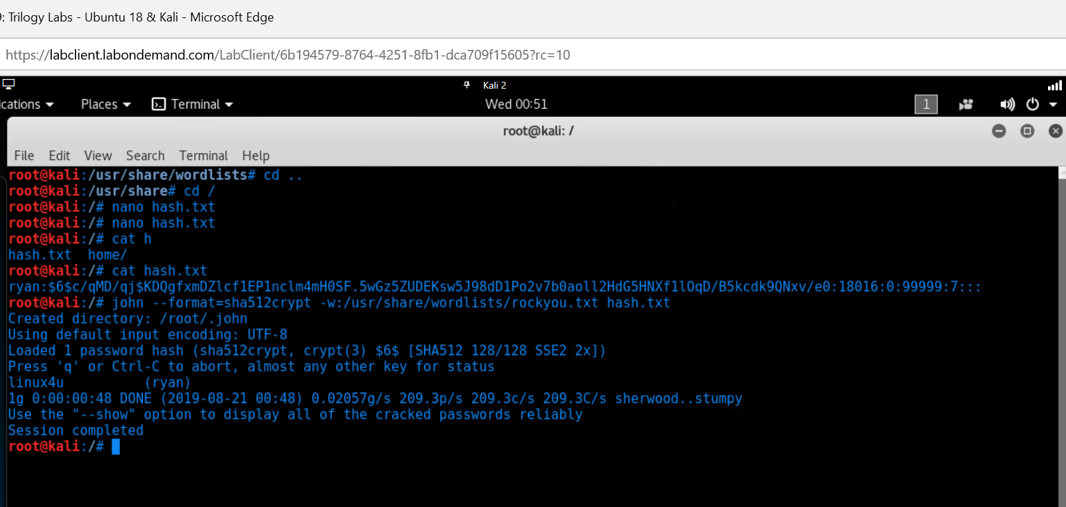
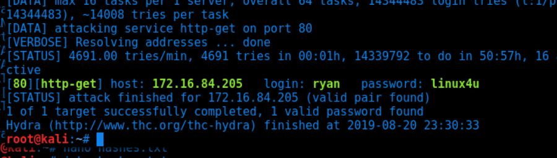
Attacking Methods:
Hydra was a tool used to brute force in Kali Linux to crack passwords.
We knew that it would would work since it was a vulnerability that had been found.
Brute force will work in the real world for penetration testing to check whether the security measures that have been done are secure to it full extent.
One of the key factors to protection is having a stronger password by 2-factor authentication and mandatory parameters such as minimum characters of 8 or more, upper/lowercase/special characters/number. Also, getting locked out if multiple failed login attempts has been made.
Or you can also copy the hash that was found in webdav and put it into a file which in this case we called it hash.txt. Afterwards run john with the name of the file (hash.txt) and will crack the password.
Notes:
LOL NUMERO
What’s up Lupe/luna the Pythong
Hola mr. unicornio haha
Probably wanna use present tense instead of past. Eh maybe not

Slide 6
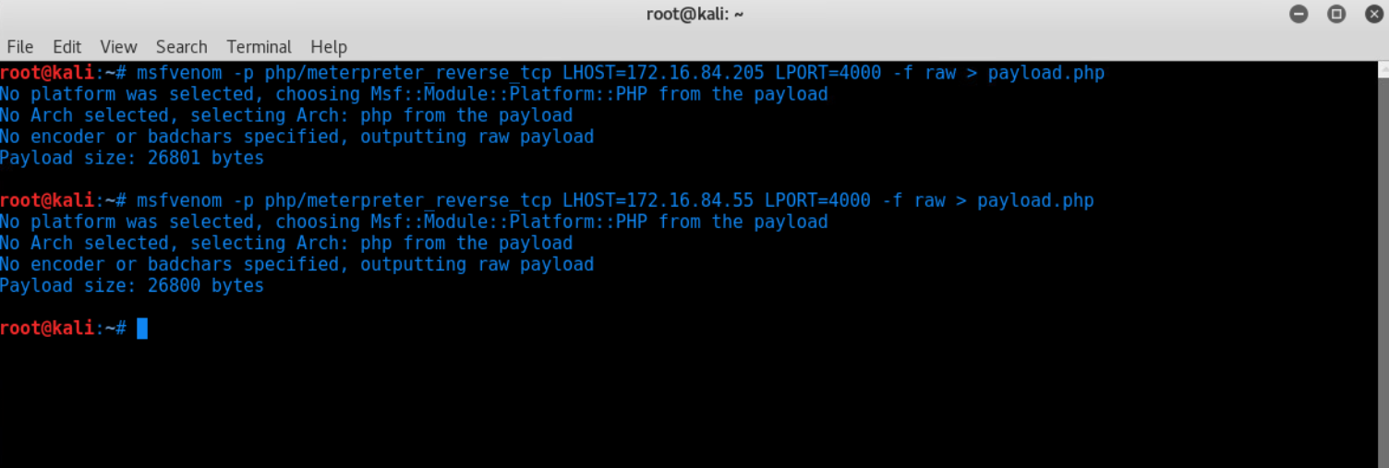
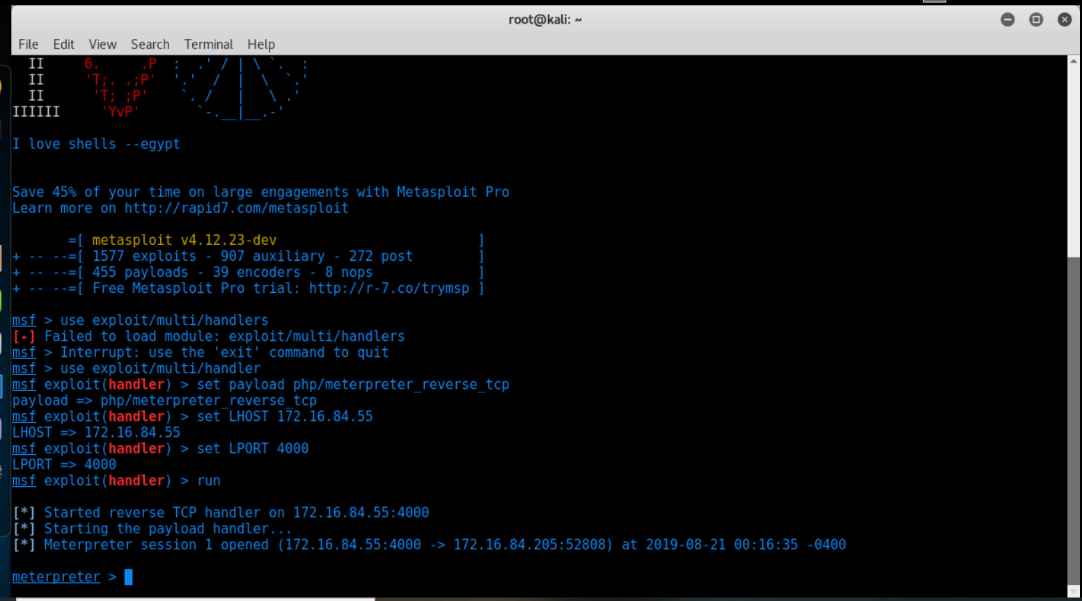
Msfvenom
Msfvenom was used in order to insert a malicious payload in raw form into the victims server.
We knew that this payload would work when we included the victim’s address when creating the payload.
This would work in the real world when you have already connected to victims server.
We would recommend to stop outgoing traffic to get out to other ports in the firewall.
As shown above inside the msfconsole:
Payload was set to php/meterpreter_reverse_tcp
We set the lhost ip address of us in order to reach the victims server.
We set the port number.
We run it in order to create the payload
Which created the meterpreter.

Slide 7
Post-exploitation
After acquiring the credentials found through brute-forcing, as well as cracking hashes found on the web server, the attacker is able to gain access to a shell on the machine. The credentials discover are as follows:
/secret_folder : user: ashton pass: leopoldo Found through brute-forcing /webdav : user: ryan pass: linux4u Found through brute-forcing and cracking the hash in /secret_folder ssh:// : user: ryan pass: linux4u Found through brute-forcing, previous used credentials, and cracking the hash found in /webdav
Notes:
When you were in the machine, what user were you?
Did you have access to the full machine?
How would you be able to defend against this exploit?
What would you do to maintain access to the server?

Slide 8
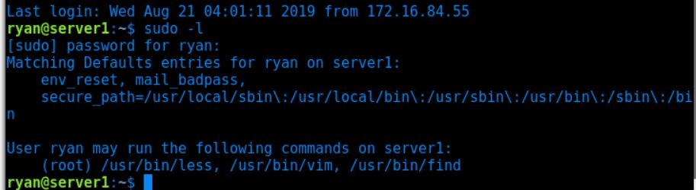
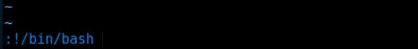
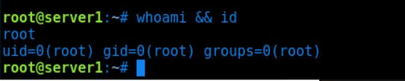
Escalation
Once a shell is gained through either SSH or a reverse shell, the attacker is using a lower level user. Upon inspection of the SSH connection the attacker is acting as the user ryan. Ryan has sudo privileges to access Vim, Less, find as root. Vim allows you to run commands through its service, and are able to spawn a root shell with the syntax “ :!/bin/bash ” gaining root privileges.
Notes:
When you were in the machine, what user were you?
Did you have access to the full machine?
How would you be able to defend against this exploit?
What would you do to maintain access to the server?

Slide 9
Access
Having root access to the machine gives the attacker full access to the machine and all it’s processes. With full access, back doors into the system are able to be opened creating a persistent threat.
Persistence can be created by - Starting a bind shell on the system - Importing ssh keys into the root directory - Adding a blank parameter to a php file on the server, passing that parameter to the system allowing Remote Code Execution.
To defend against these persistent threats, stronger passwords, policy of least privileges, and setuid mitigation is recommended.

Slide 10
Incident Response - Summary
Upon analyzing the log file
There were 10145 authentication attempts against Ashton’s credential utilizing Hydra from IP address 172.16.84.213 to web server 172.16.84.205
The first authentication against the “Secret Folder” Started at 2019/05/06 09:32:29
Hacker found Ashton’s password on 2019/05/06 09:36:23
Ashton’s password was brute forced within 4 minutes
Ryan’s password was utilized to access WebDav
Reverse Shell file “shell.php” was uploaded on 2019/05/06 09:37:14
The file reuploaded on 2019/05/06 09:38:57 and the shell was activated on 2019/05/06 09:40:46

Slide 11
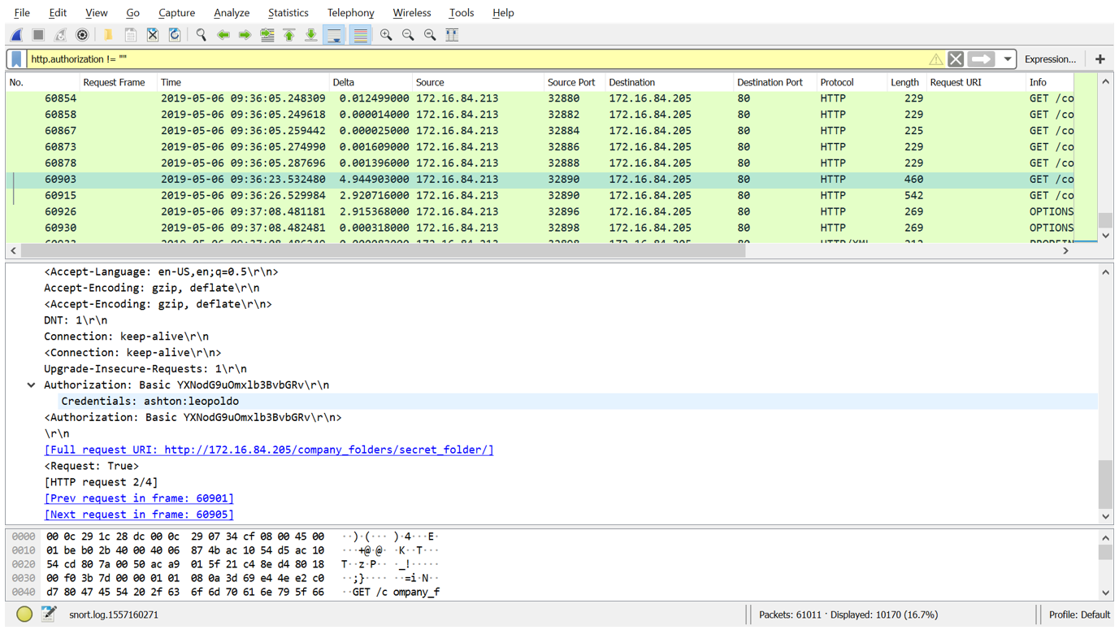
Incident Response - Password Brute Force

Slide 12
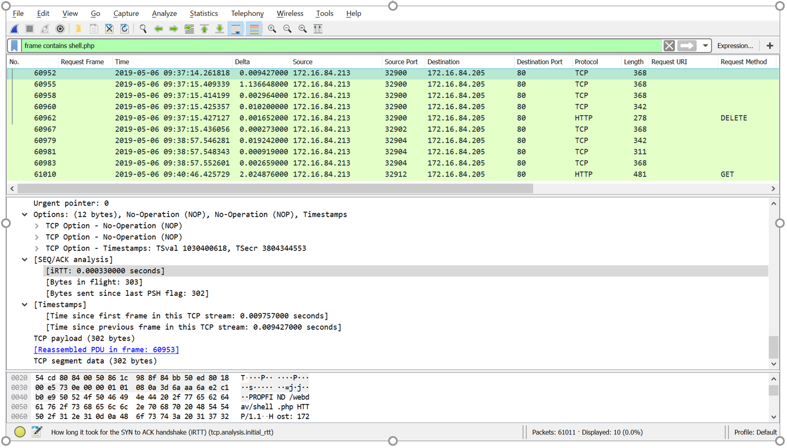
Incident Response - Reverse Shell

Slide 13
Mitigation
Limit the # of incorrect authentication attempts to prevent brute force by using identifying cookies or unique browser elements
Increase password complexity to a minimum of 10 characters, upper, lower cases, 2 to 5 numbers and special characters to increase password entropy
Implement “reCaptcha” to prevent robot or automation brute force on sensitive fields
Do not use the same password for multiple logins
Do not store any form of passwords on a public facing server
Disable directory indexing on website’s folder

Slide 14
Mitigate Privesc
Limit the use of sudo for find
Can be used to find and execute as root any command on a searched file
Limit the use of sudo for vim
Vim can run commands within its shell, so running Vim as root allows it to create a root bash shell
Limit the use of sudo for less
Less can be abused by using it to launch vi, which can spawn a shell
Notes:
https://en.wikipedia.org/wiki/Setuid

